Slide 1
Sampling and Estimation

Slide 2
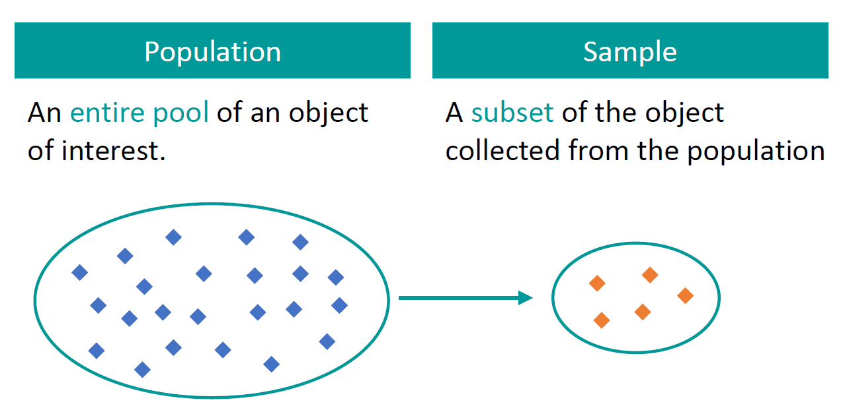
Sampling and Population
Population (N) = Entire group of subjects we are interested in
Sample (n) = A smaller group within the larger population

Slide 3
Sampling Techniques
Probability sampling involves random selection
Every member of the population has a chance of being selected
Mainly used in quantitative research
Most appropriate
Non-probability sampling involves non-random selection
Not every individual has a chance of being included
Easier and cheaper to access, but it has a higher risk of sampling bias
Used in qualitative research

Slide 4
Probability Sampling
Simple random sampling
Systematic sampling
Stratified sampling
Cluster sampling

Slide 5
Simple Random Sampling
In a simple random sample, every member of the population has an equal chance of being selected
Tools like random number generators are used
Example: To select a simple random sample of 100 employees of a company, we can assign a number to every employee in the company database from 1 to 1000, and use a random number generator to select 100 numbers

Slide 6
Systematic Sampling
Systematic sampling is similar to simple random sampling, but it is easier to conduct
Instead of randomly generating numbers, individuals are chosen at regular intervals
Example: All employees of the company are listed in alphabetical order and we select employee numbers 6, 16, 26, 36, …, so that we have 100 samples

Slide 7
Stratified Sampling
Stratified sampling divides the population into subpopulations (strata) based on the relevant characteristic (e.g. gender, age range, income bracket, job role)
Random or systematic sampling is used to select a proportionate sample from each subgroup
Example: If a company has 800 female employees and 200 male employees, we may select 80 women and 20 men

Slide 8
Cluster Sampling
Cluster sampling also divides the population into subgroups, but of sampling individuals from each subgroup, we randomly select entire subgroups
Good for dealing with large and dispersed populations, but there is more risk of error in the sample
Example: A company has offices in 10 cities across the country, so we randomly select 3 offices – these are our clusters

Slide 9
Non-Probability Sampling
Convenience sampling
Voluntary response sampling
Purposive sampling
Snowball sampling

Slide 10
Convenience Sampling
A convenience sample simply includes the individuals who happen to be most accessible to the researcher
Easy and inexpensive
May not guarantee sufficient coverage, different parts of the population
Example: To research opinions about student support services in our university, we ask your fellow students to complete a survey on the topic

Slide 11
Voluntary Response Sampling
A voluntary response sample is mainly based on ease of access
Instead of the researcher choosing participants and directly contacting them, people volunteer themselves (e.g. by responding to a public online survey)
Always at least somewhat biased, as some people will inherently be more likely to volunteer than others
Example: Generally people who respond to surveys are more likely to be those who have strong opinions about the topic

Slide 12
Purposive Sampling
In purposive sampling, also known as judgement sampling, the researchers use their expertise to select a sample that is most useful to the purposes of the research
Often used in qualitative research, where the researcher wants to gain detailed knowledge about a specific phenomenon rather than make statistical inferences
Example: We want to know more about the opinions and experiences of foreign students at our university, so we purposefully select a number of students from different countries in order to gather a varied range of data on their experiences with student services

Slide 13
Snowball Sampling
If the population is hard to access, snowball sampling can be used to recruit participants via other participants
The number of people we have access to “snowballs” as we get in contact with more people
Example: We are researching experiences of homelessness in your city and we meet one person who agrees to participate in the research – That person puts us in contact with other homeless people in the area

Slide 14
Unbalanced Data
We have unbalanced data when there is a large discrepancy between positive and negative cases
Example: Fraud is rare and most rows in the dataset will be ‘No fraud’
Solutions:
Oversampling: Randomly duplicate samples from the minority class to increase the size of the minority class
Undersampling: Randomly remove samples from the majority class – Usually not recommended
SMOTE (Synthetic Minority Oversampling Technique): Artificially generate new samples of the minority class using nearest neighbors
Run K-nearest-neighbors of each sample in the minority class
Create a sample from the KNN result (mean of the neighbors)

Slide 15
Hands-On
C:\code\Data Analytics\smote.py

Slide 16
The Central Limit Theorem (CLT)

Slide 17
Central Limit Theorem (CLT)
From a population, we draw samples
Example: From 1 lakh purchase transactions, we randomly select groups of 1000 transactions each
For each sample, suppose we calculate average order amount (called sample mean)
Now if we plot these sample means for a sufficient number of samples, these sample means would form a normal distribution (See next slide)
This is called as the Central Limit Theorem (CLT)

Slide 18
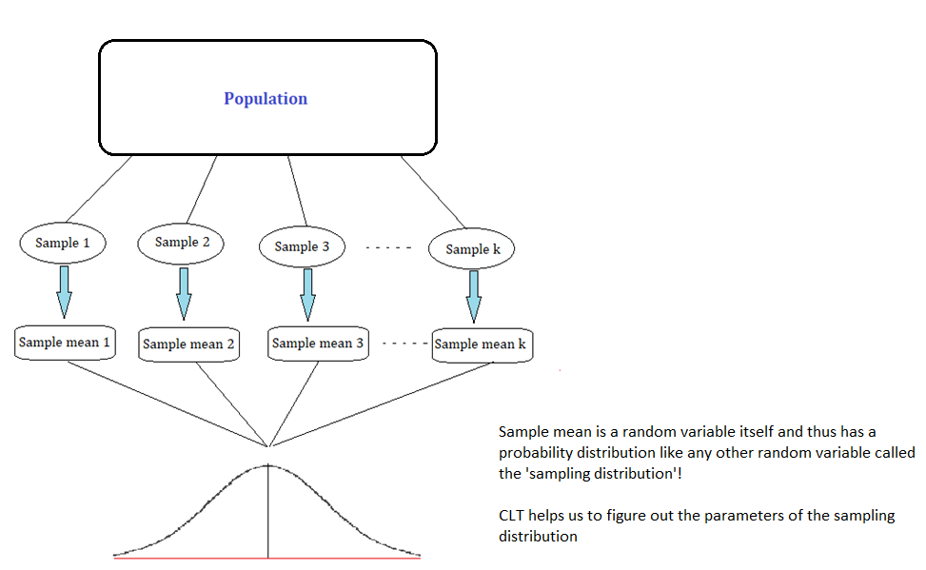
Central Limit Theorem (CLT) Visualized

Slide 19
Use of CLT
Based on the sample mean, we can make inferences about the population parameters, subject to certain conditions
Allows us to make probabilistic statements about sample statistics, even when the population distribution is not known, or is not normally distributed
Hypothesis testing usually relies on assumptions made about the distribution of sample statistics
Since CLT establishes normality of the sampling distribution of the mean, we can use tests such as t-test, z-test, which are applicable on normal distribution

Slide 20
CLT Example
C:\code\Data Analytics\CLT.py
C:\code\Data Analytics\CLT-titanic.py

Slide 21
Hypothesis Testing

Slide 22
Dependent and Independent Variables
Dependent variable (Outcome variable): The variable we are trying to explain
Independent variables (Explanatory variables): The variables we use to explain the dependent variable
Examples
Years of experience, Skills (Independent) -> Salary (Dependent)
Number of hours spent studying (Independent) -> Test score (Dependent)

Slide 23
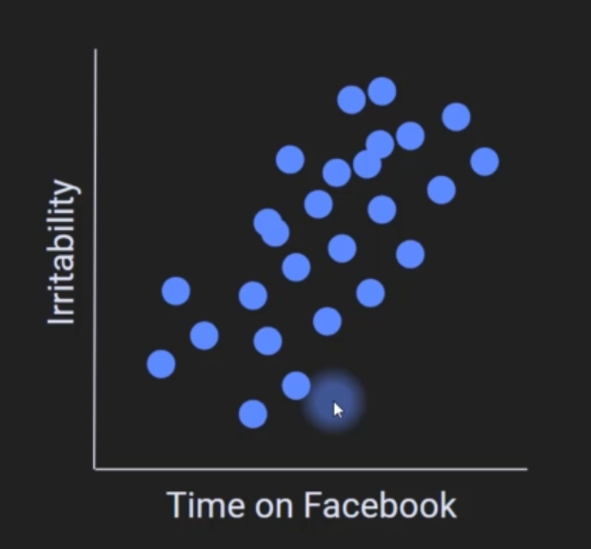
Placing Dependent and Independent Variables
Independent variables are on the x-axis and dependent variables are on the y-axis

Slide 24
Hypothesis
Hypothesis is a guess made before an experiment to see if we are right – it should be clear, specific, falsifiable, a statement
Good hypothesis: This medication reduces symptom X by 20% in 8 weeks
Bad hypothesis: Medical research is important for curing diseases
Good hypothesis: A combination of theory study and lab practice will improve the final score by at least 10%
Bad hypothesis: Will students pass this course?

Slide 25
Null and Alternate Hypotheses
Null Hypothesis (H₀): The type of advertisement has no effect on purchase of the product
Alternate Hypothesis (H_{a}): People purchase more units of the product after seeing advertisement X than advertisement Y
We never prove/accept a hypothesis
We either reject or do not reject a hypothesis

Slide 26
One-Sample T-test

Slide 27
One-sample T-test
A one-sample t-test is a statistical hypothesis test used to determine if there is a significant difference between the mean of a sample and a known or hypothesized population mean
Define H₀ as Sample mean = Population mean and H_{a} as Sample mean <> Population mean
Collect data sample, calculate sample mean and sample SD
Choose significance level (generally 5%)
Calculate test statistic (t)
t = (Sample mean – Hypothesized population mean) / (Sample SD / √Sample size)

Slide 28
One-Sample T-test : Example
It is claimed that the average amount of coffee in a cup is 12 units
We collect a random sample of 20 cups and measure the amount of coffee in each cup
H0: Hypothesized Population Mean (HPM) = 12, Ha: HPM ≠ 12
Suppose for our sample, sample mean (SM) = 11.5, SD = 1.2
t = (SM - HPM) / (s / √n) = (11.5 – 12) / (1.2 / √20) = 2.08
Degrees of freedom = Sample size – 1 = 20 – 1 = 19
Look in T-table (See next slide)

Slide 29
One-Sample T-test : Example
T-table: At https://www.sjsu.edu/faculty/gerstman/StatPrimer/t-table.pdf, look for DF 19 and two-tails value of 0.05
Why 0.05? Because confidence interval is 95%, so significance level (alpha) is 0.05
Since the absolute value of our calculated t-statistic (2.08) is less than the critical t-value (2.093) for a two-tailed test we fail to reject the null hypothesis
Conclusion: We do not have enough evidence to conclude that the average amount of coffee in a medium-sized cup served by the company is different from 12 units

Slide 30
One-sample T-test: Code Example
Example: Assess whether the average sugar level in a sample of patients is significantly different from a reference value
Null Hypothesis (H₀): The average sugar level in the sample is equal to the hypothesized population mean or reference value
Alternative Hypothesis (H₁): The average sugar level in the sample is different from the hypothesized population mean

Slide 31
One Sample t-test Code
import scipy.stats as stats
# Sample sugar level data
sugar_levels = [125, 130, 118, 122, 128, 115, 130, 135, 120, 125]
# Hypothesized population mean (recommended threshold)
hypothesized_mean = 120
# Perform one-sample t-test
t_statistic, p_value = stats.ttest_1samp(sugar_levels, hypothesized_mean)
# Compare p-value to significance level (e.g., 0.05)
alpha = 0.05
if p_value < alpha:
print("Reject the null hypothesis. The average sugar level is significantly different.")
else:
print("Fail to reject the null hypothesis. No significant difference in average sugar level.")

Slide 32
One-sample T-test: Conclusion
Find critical t-value from t-table
If calculated t-statistic > critical value, reject H₀
If we reject H₀, there is a significant difference between the sample mean and the hypothesized population mean
If we fail to reject H₀, we cannot conclude that there is a significant difference between the sample mean and the hypothesized population mean

